Slide 1

Diamond deals
Unraveling the Metrics and Money in MLB Player Transactions
Hayden Ravert
Woz U

Slide 2
Background
Hayden Ravert
B.S. Astrophysics From Towson University
10 years of Retail Management
A lifetime of watching and analyzing Baseball

Slide 3

Project Question
What is the financial value of free agent players in Major League Baseball?

Slide 4
Determining A Players Value
Players Position
Pitcher vs. Position Player?
Player Statistics
Which statistics should we use?
Statistics vs. Salary
How do the stats influence salary?

Slide 5
Pitcher
Stats
ERA – Earned Run Average
Number of Runs per nine innings (Lower Better)
WHIP – Walks and Hits per Inning
How well a pitcher keeps players off base (Lower Better)
-IP – Innings Pitched
Number of innings pitched over a season (Higher Better)
-W – Wins
Pitcher of record with a lead after five innings when starting or most effective relief pitcher (Higher Better)
-SV – Saves
Pitcher who gets the last three outs with a lead of no more that three runs (Higher Better)

Slide 6
Position Players
Stats
H – Hits
When a player hits the ball in fair territory and reaches base (Higher Better)
RBI – Runs Batted In
When a player's plate appearance results in a run scored (Higher Better)
HR – Home Runs
When a player scores who hit the ball in fair territory (Higher Better)
AVG – Batting Average
Total Hits divided by Total At Bats (Higher Better)
OPS – On Base Percentage Plus Slugging
How well a hitter can reach base and how well he can hit for average and power (Higher Better)

Slide 7
WAR
Wins Above Replacement
Measures a player’s win value versus a replacement player at the same position(usually a Minor League replacement) (Higher Better)
WAR = (Batting Runs + Base Running Runs +Fielding Runs + Positional Adjustment + League Adjustment +Replacement Runs) / (Runs Per Win)
WAR = [[([(League “FIP” – “FIP”) / Pitcher Specific Runs Per Win] + Replacement Level) * (IP/9)] * Leverage Multiplier for Relievers] + League Correction

Slide 8
Gathering Data Methods
All data from spotrac.com
Free Agent Signings of seasons 2019-2023
Player, Position, Age, Bats, Throws, Team From, Team To, Years Signed, Total Salary, Average Yearly Salary
Stats of players from seasons 2018-2022
H, RBI, HR, AVG, OPS, IP, ERA, WHIP, W, SV, WAR
Starting with 679 Samples

Slide 9
Manipulating Data
Add Player Id column
Split the data into Pitcher and Position Player
Created dummy variables to match positions to separate
Drop irrelevant columns
Position, Bats, Throws, From, To
Drop missing values or change to 0
Pitchers
Age, Average Salary, Innings Pitched, ERA, WHIP, Wins, Saves, WAR
Sample Size 331
Position Players
Age, Average Salary, Hits, RBI, HR, AVG, OPS, WAR
Sample Size 278

Slide 10
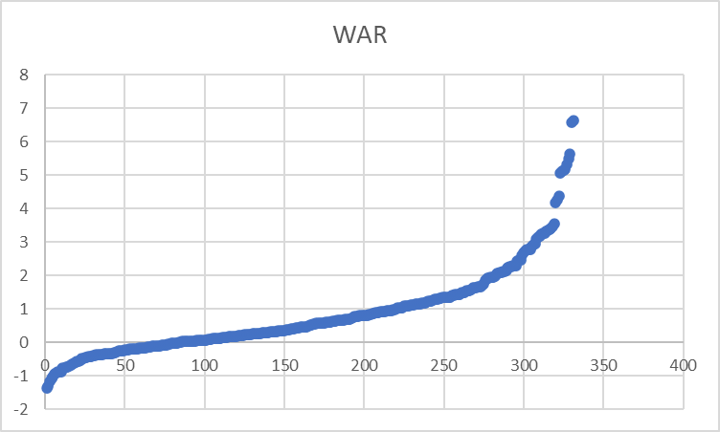
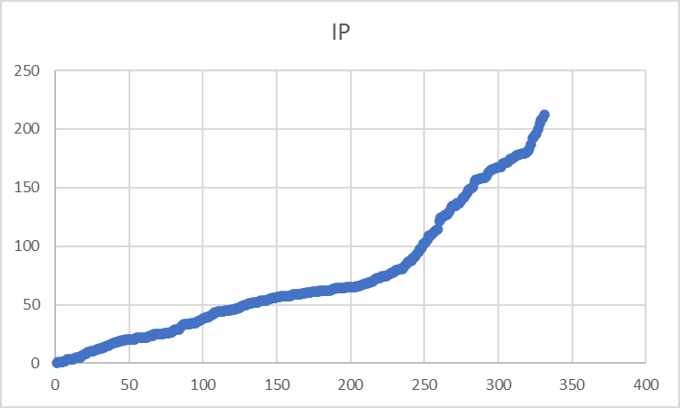
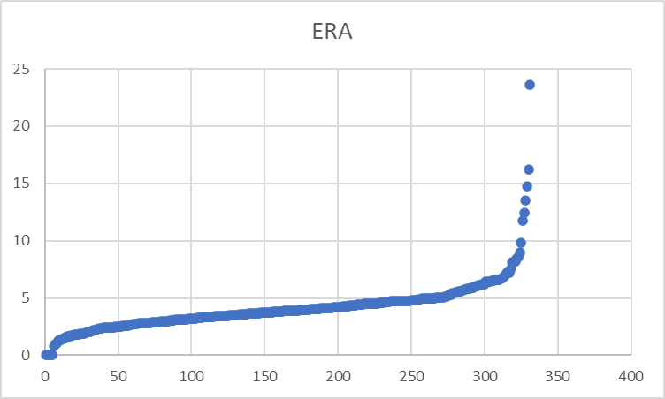
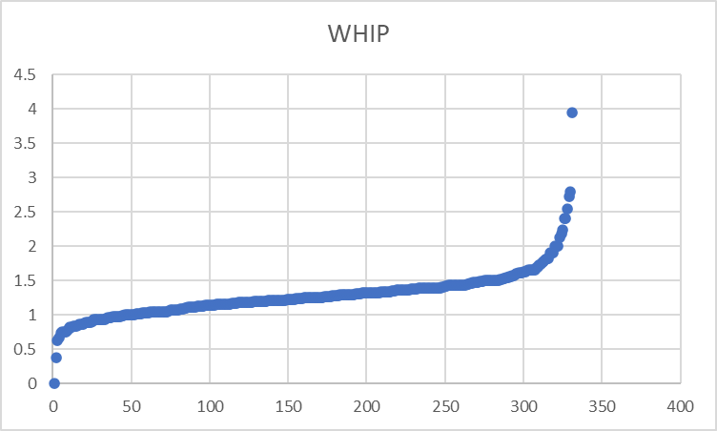
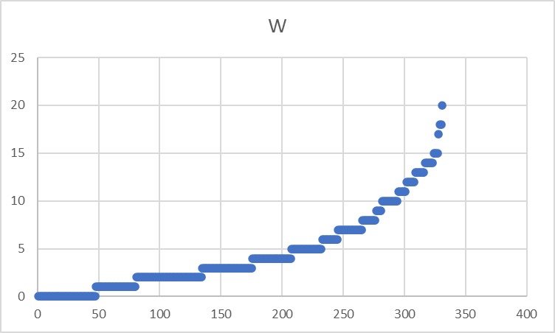
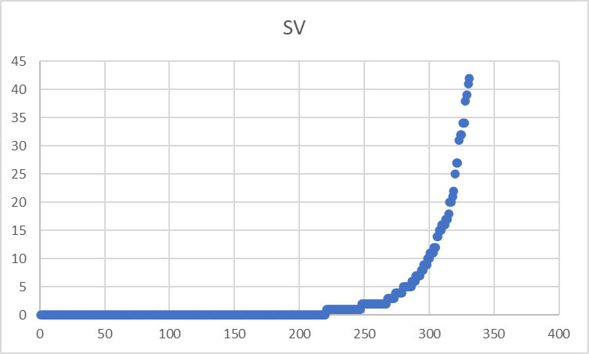
Pitcher Data Exploration

Slide 11
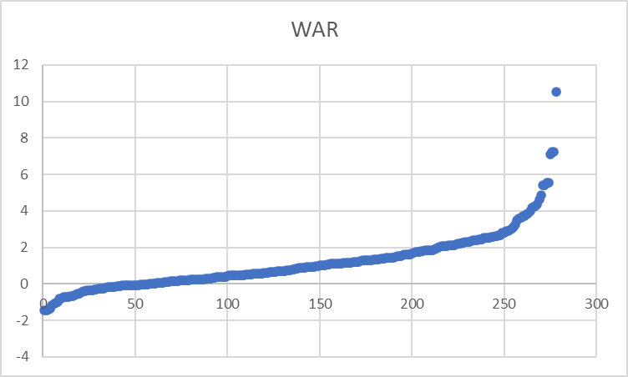
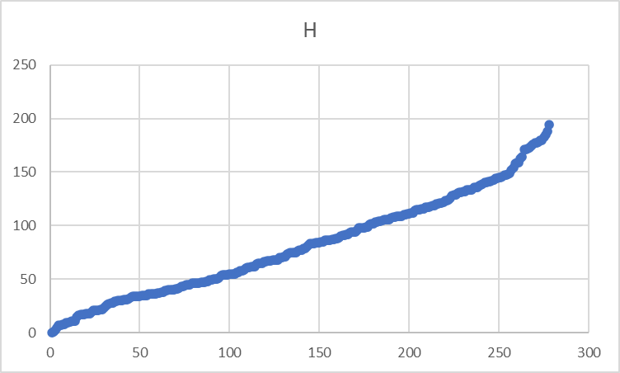
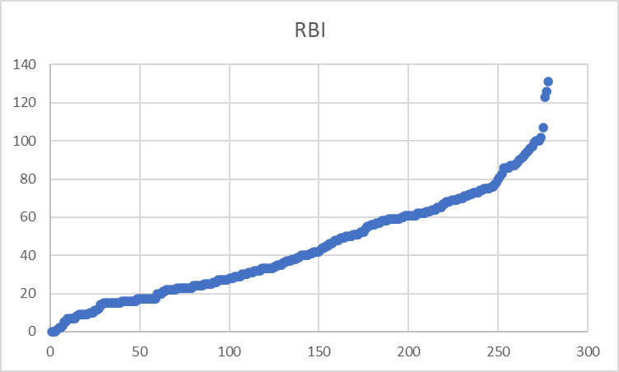
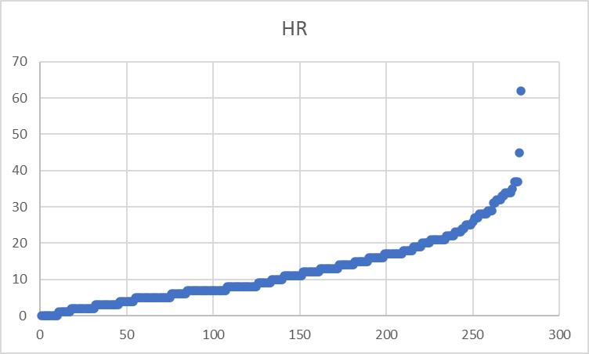
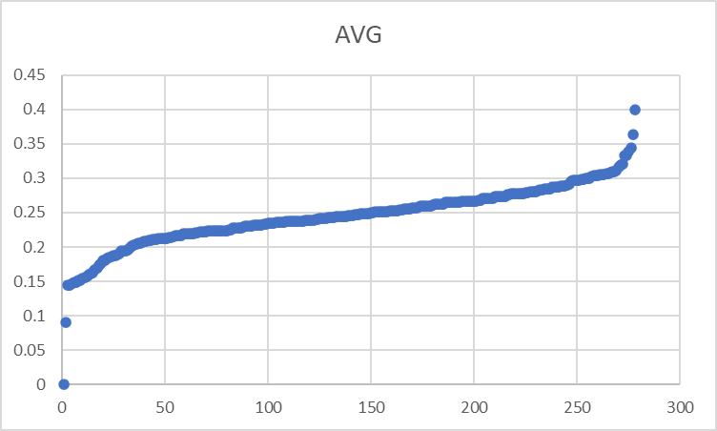
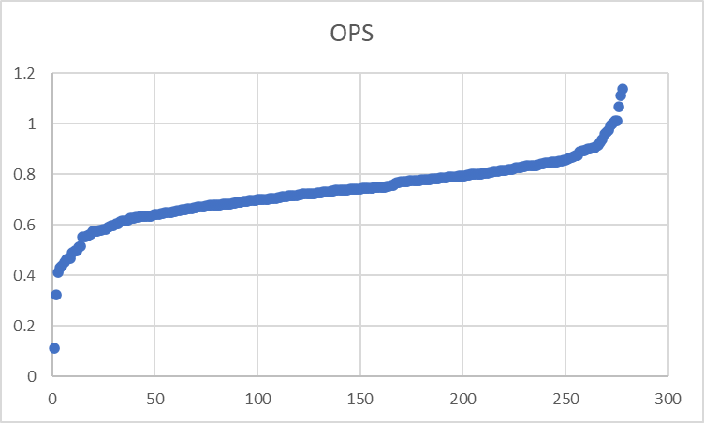
Position Player Data Exploration

Slide 12
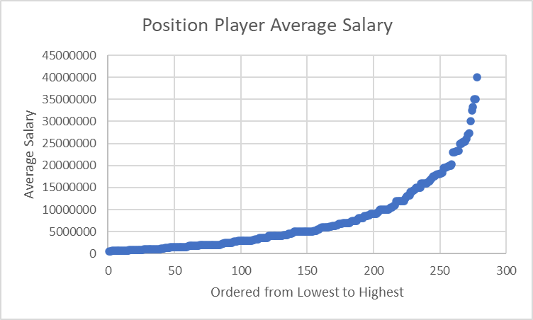
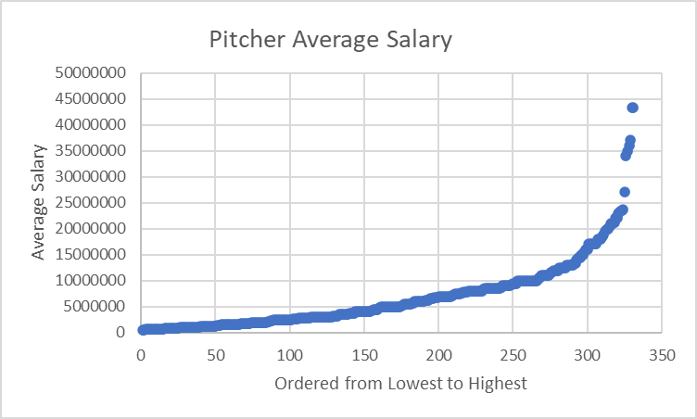
Salary Data Exploration

Slide 13
Analysis Methods
Stepwise Exponential Regression
Method used to model the relationship between a dependent variable and one or more independent variables that adds or removes predictor variables from the model in a step-by-step fashion.
Mediation
Analysis used to explore the indirect effect of an independent variable on a dependent variable through a variable with a causal relationship.
Moderation
Analysis that examines the influence of a third variable on the strength or direction of the relationship between an independent variable and a dependent variable.

Slide 14
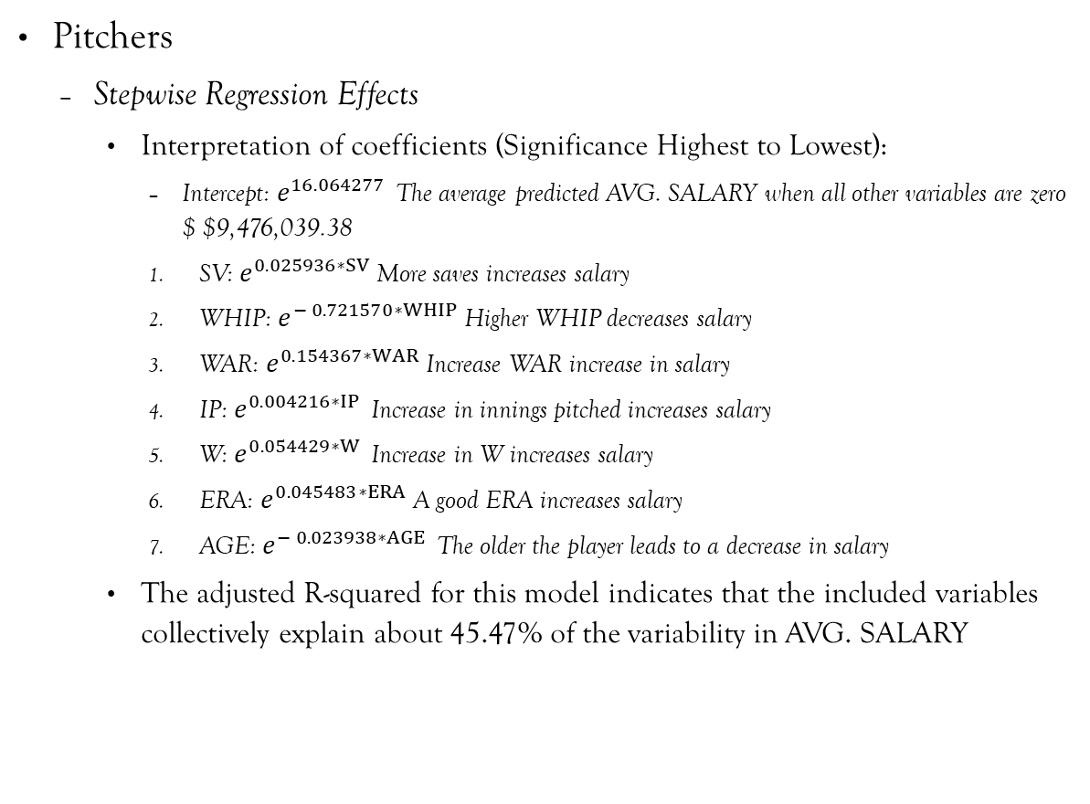
Exponential Regression Results
Pitchers
Stepwise Regression Effects
Interpretation of coefficients (Significance Highest to Lowest):
Intercept: $e^{16.064277 }$The average predicted AVG. SALARY when all other variables are zero $ $9,476,039.38
SV: $e^{0.025936∗SV}$More saves increases salary
WHIP: $e^{− 0.721570∗WHIP}$Higher WHIP decreases salary
WAR: $e^{0.154367∗WAR}$Increase WAR increase in salary
IP: $e^{0.004216∗IP }$Increase in innings pitched increases salary
W: $e^{0.054429∗W }$Increase in W increases salary
ERA: $e^{0.045483∗ERA}$A good ERA increases salary
AGE: $e^{− 0.023938∗AGE }$The older the player leads to a decrease in salary
The adjusted R-squared for this model indicates that the included variables collectively explain about 45.47% of the variability in AVG. SALARY

Slide 15
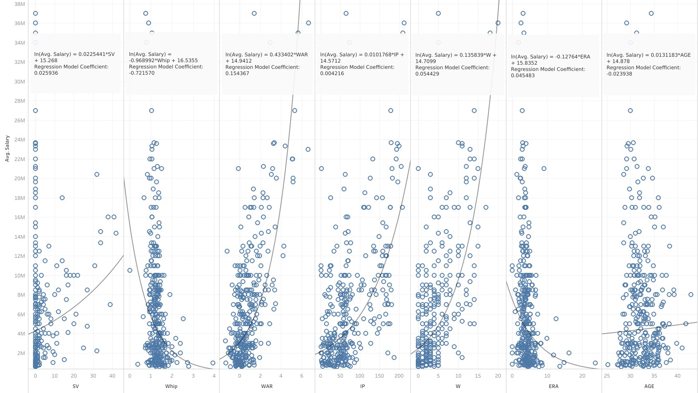

Slide 16
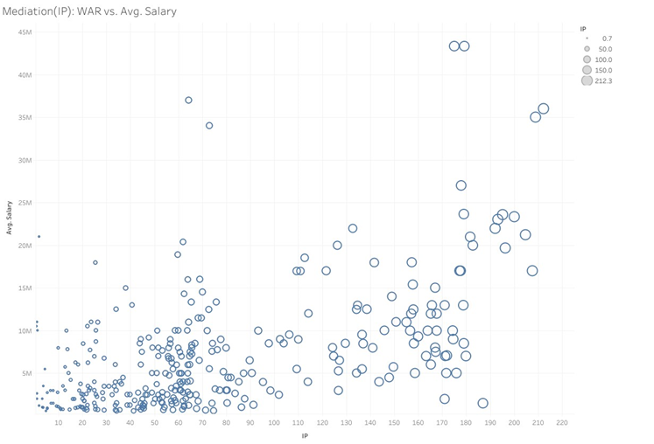
Mediation Analysis of IP
Indirectly effects 36.9% WAR on Salary

Slide 17
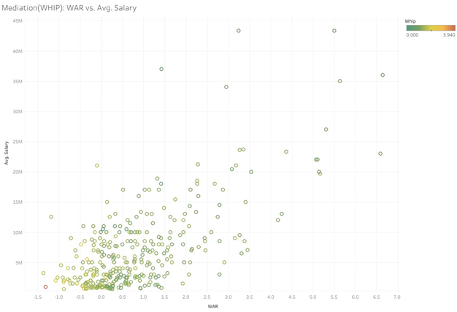
Mediation Analysis of WHIP
Indirectly effects 9.204% WAR on Salary

Slide 18
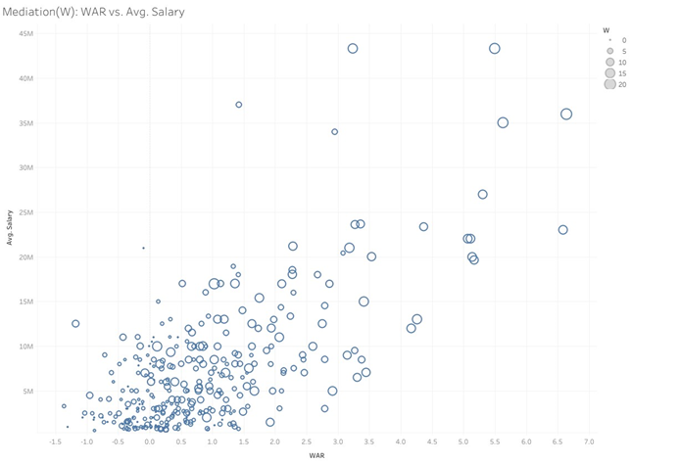
Mediation Analysis of W
Indirectly effects 45.2% WAR on Salary

Slide 19
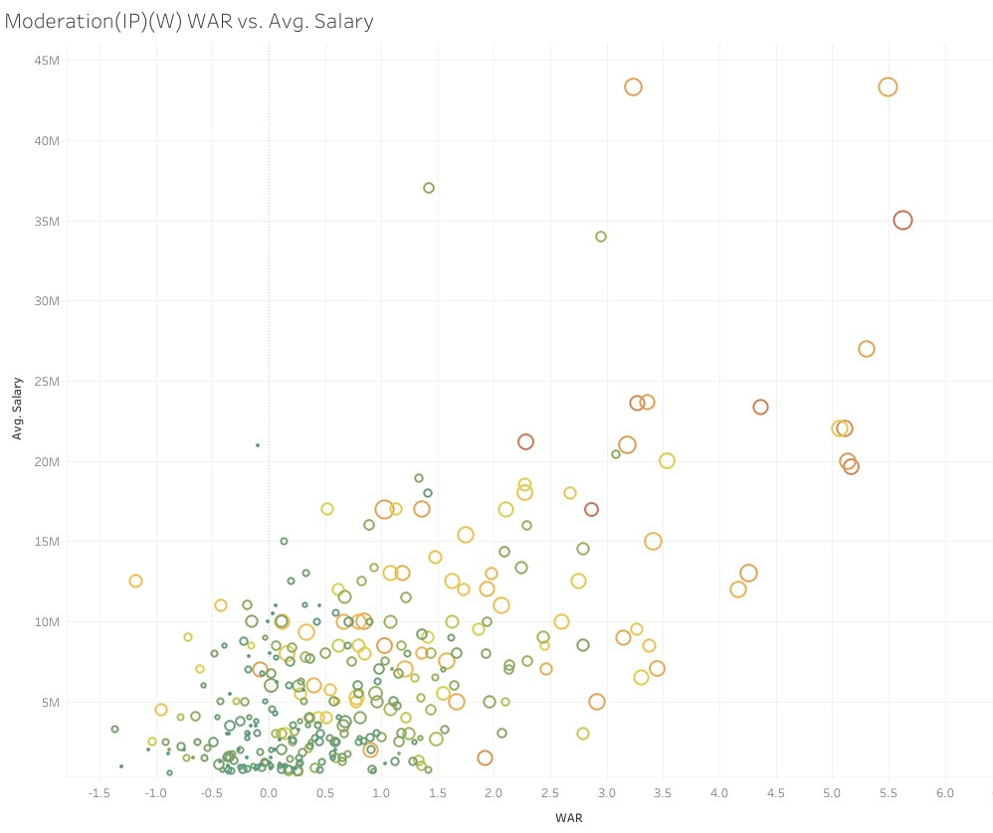
Moderation Analysis
IP
Coefficient: -0.0012974
Influences 39.66% on WAR and Salary
W
Coefficient: -0.01393
Influences 40.07% on WAR and Salary

Slide 20
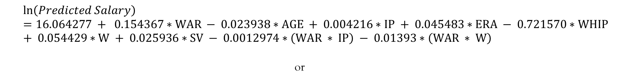
Predicted Salary Equation
$$\ln\left(Predicted Salary\right)=16.064277 + 0.154367∗WAR − 0.023938∗AGE + 0.004216∗IP + 0.045483∗ERA − 0.721570∗WHIP + 0.054429∗W + 0.025936∗SV − 0.0012974∗\left(WAR ∗ IP\right) − 0.01393∗\left(WAR ∗ W\right)$$
or
$$Predicted Salary=e^{(16.064277 + 0.154367∗WAR − 0.023938∗AGE + 0.004216∗IP + 0.045483∗ERA − 0.721570∗WHIP + 0.054429∗W + 0.025936∗SV − 0.0012974∗\left(WAR ∗ IP\right) − 0.01393∗\left(WAR ∗ W\right))}$$

Slide 21
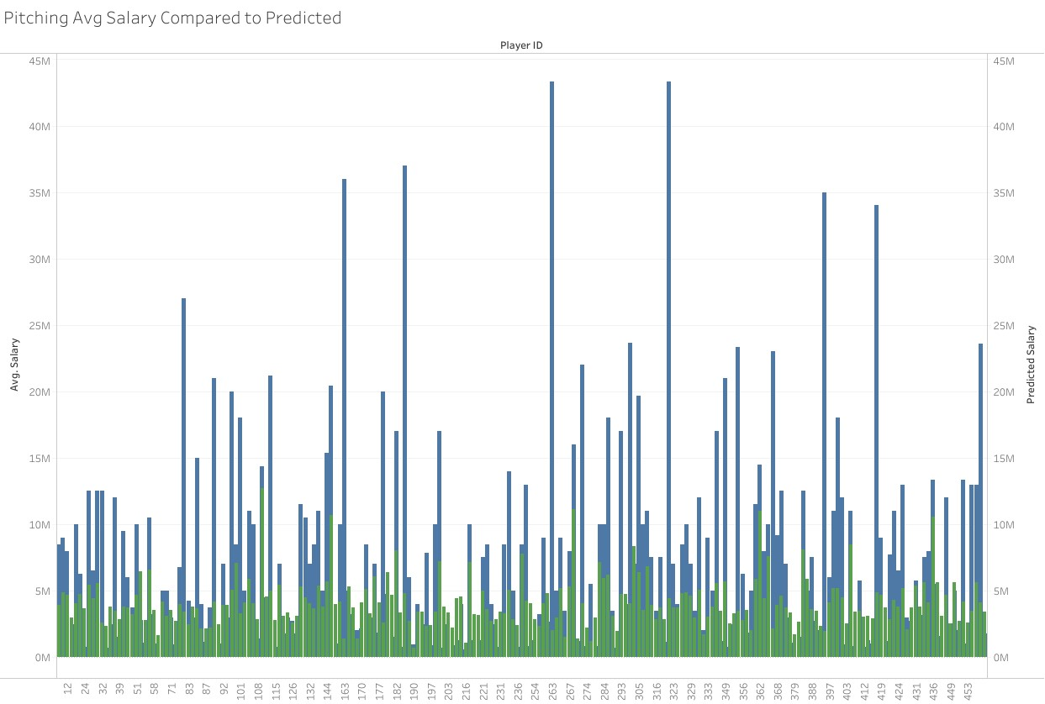
Comparison

Slide 22
Percent Difference
Percent Difference = ((Predicted - Observed)/Observed) *100%
Over the whole Pitching Dataset
Average = 13.44%
Standard Deviation = 1.051311

Slide 23
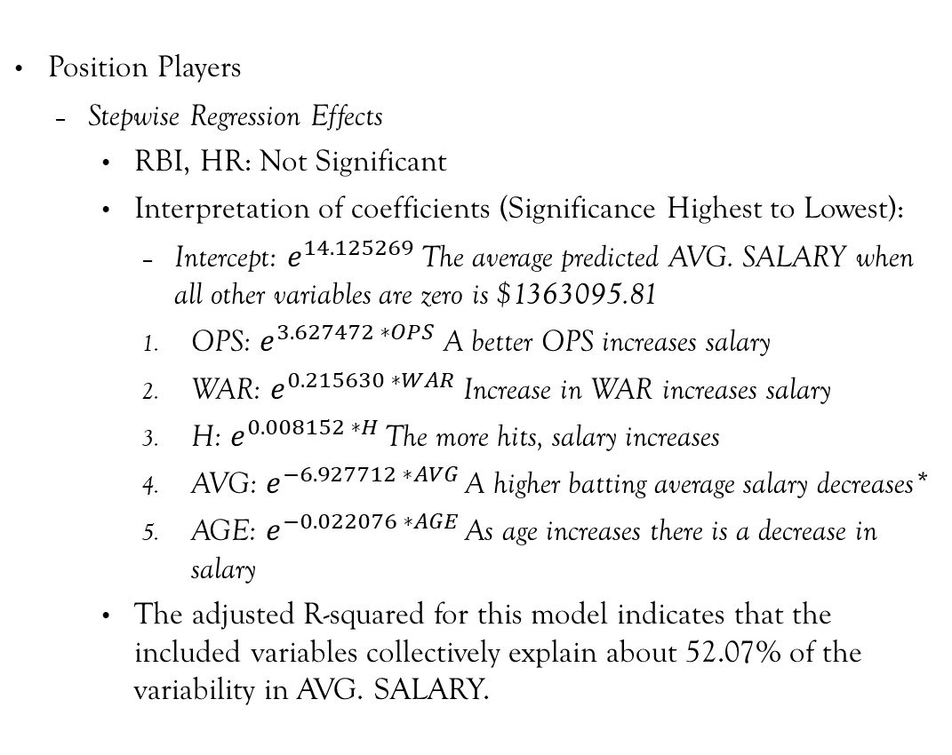
Exponential regression Results
Position Players
Stepwise Regression Effects
RBI, HR: Not Significant
Interpretation of coefficients (Significance Highest to Lowest):
Intercept: $e^{14.125269}$The average predicted AVG. SALARY when all other variables are zero is $1363095.81
OPS: $e^{3.627472 ∗OPS}$ A better OPS increases salary
WAR: $e^{0.215630 ∗WAR}$ Increase in WAR increases salary
H: $e^{0.008152 ∗H }$The more hits, salary increases
AVG: $e^{−6.927712 ∗AVG }$A higher batting average salary decreases*
AGE: $e^{−0.022076 ∗AGE }$As age increases there is a decrease in salary
The adjusted R-squared for this model indicates that the included variables collectively explain about 52.07% of the variability in AVG. SALARY.

Slide 24
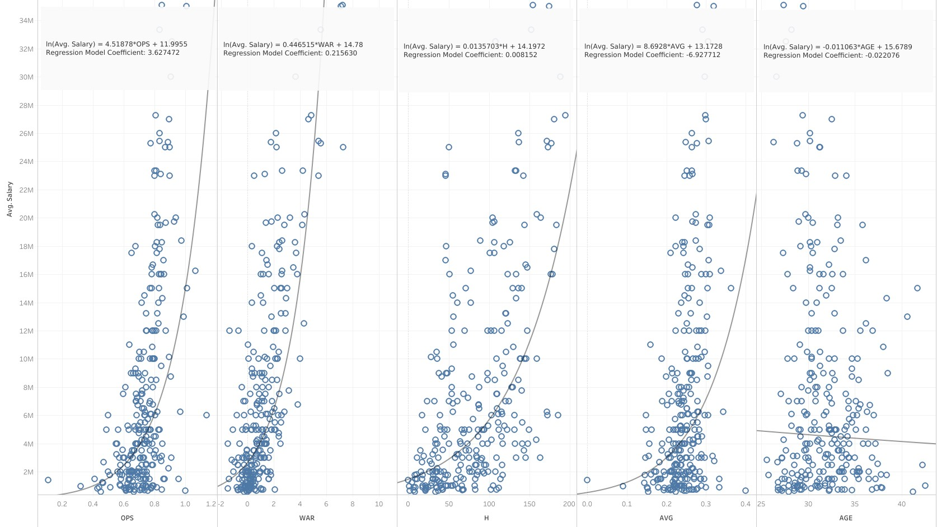

Slide 25
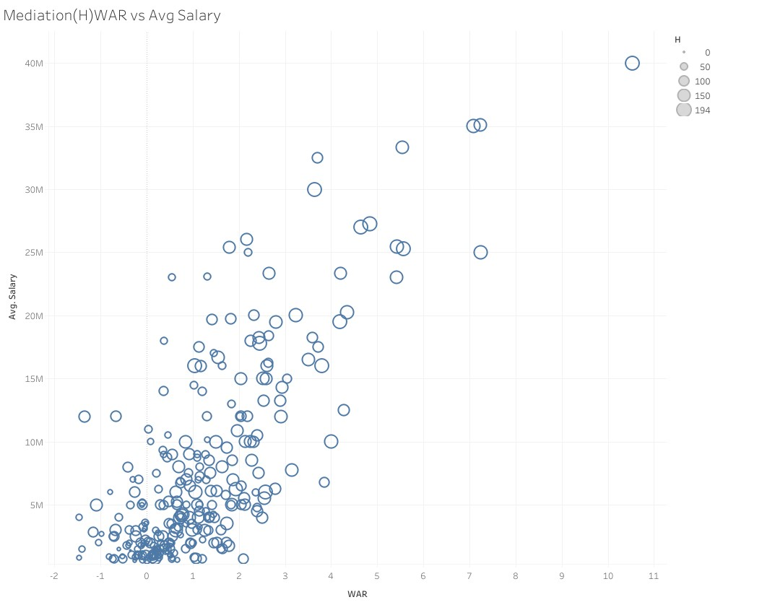
Mediation Analysis of H
Indirectly effects 30.30% WAR on Salary

Slide 26
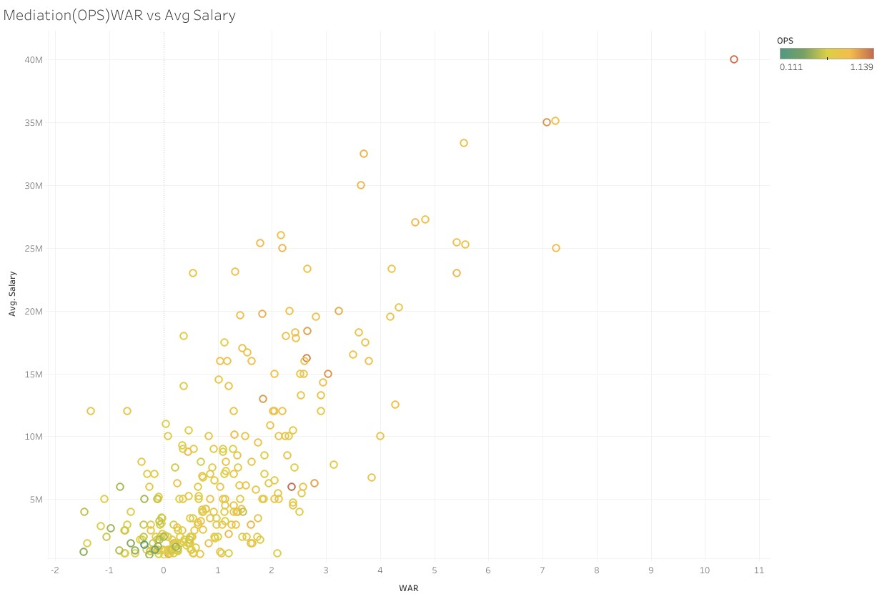
Mediation Analysis of OPS
Indirectly effects 17.05% WAR on Salary

Slide 27
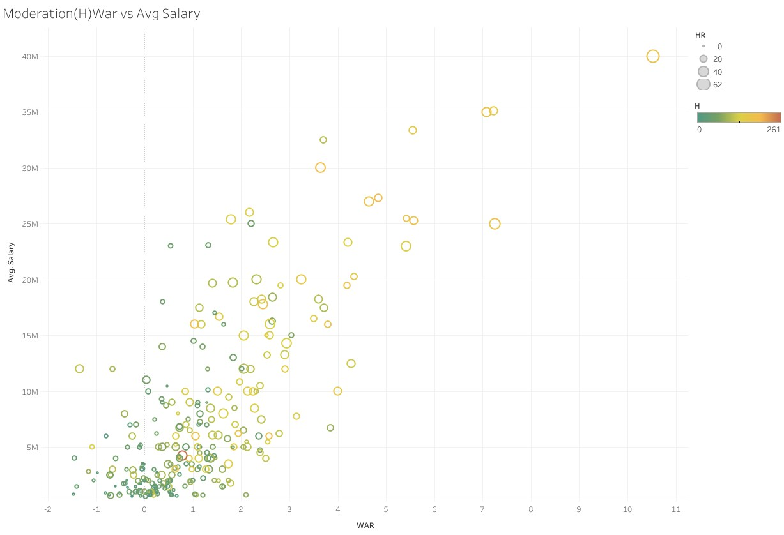
Moderation Analysis
H
Coefficient: -0.0018766
Influences 49.25% on WAR and Salary

Slide 28
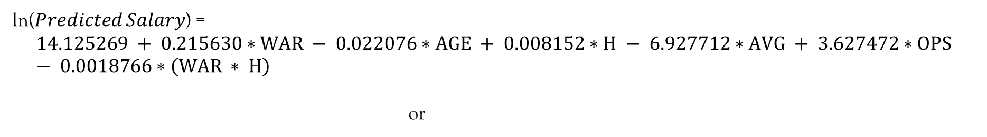
Prediction Equation
ln⁡(𝑃𝑟𝑒𝑑𝑖𝑐𝑡𝑒𝑑 𝑆𝑎𝑙𝑎𝑟𝑦) =
$$14.125269 + 0.215630∗WAR − 0.022076∗AGE + 0.008152∗H − 6.927712∗AVG + 3.627472∗OPS − 0.0018766∗\left(WAR ∗ H\right)$$
or
$$Predicted Salary=e^{(14.125269 + 0.215630∗WAR − 0.022076∗AGE + 0.008152∗H − 6.927712∗AVG + 3.627472∗OPS − 0.0018766∗\left(WAR ∗ H\right))}$$

Slide 29
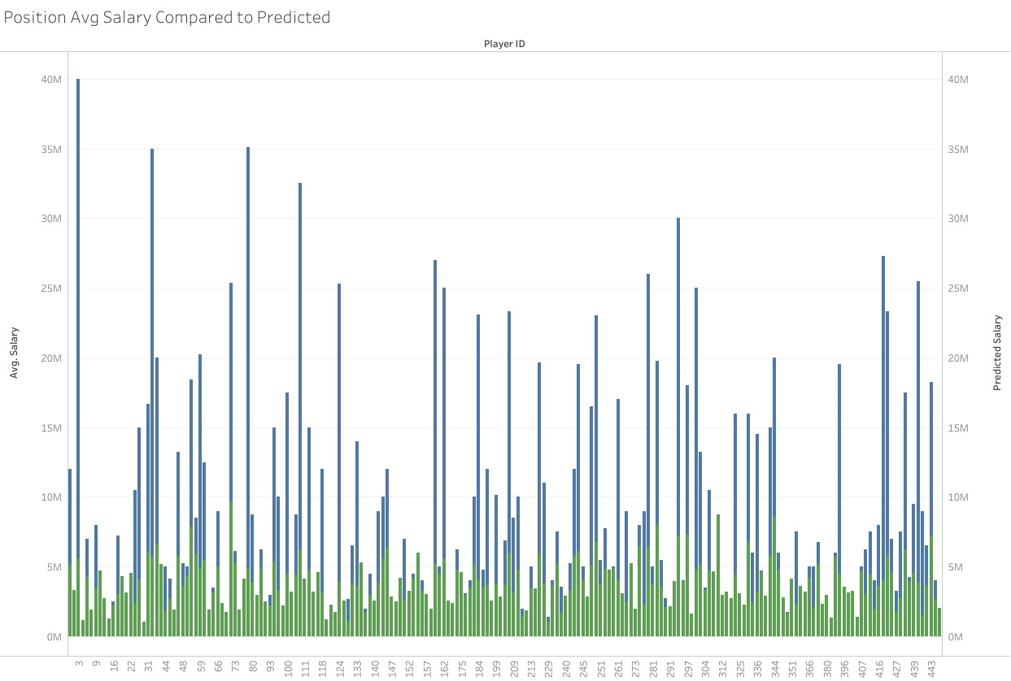
Comparison

Slide 30
Percent Difference
Percent Difference = ((Predicted - Observed)/Observed) *100%
Over the whole Position Player Dataset
Average = 8.75%
Standard Deviation = .09736621

Slide 31
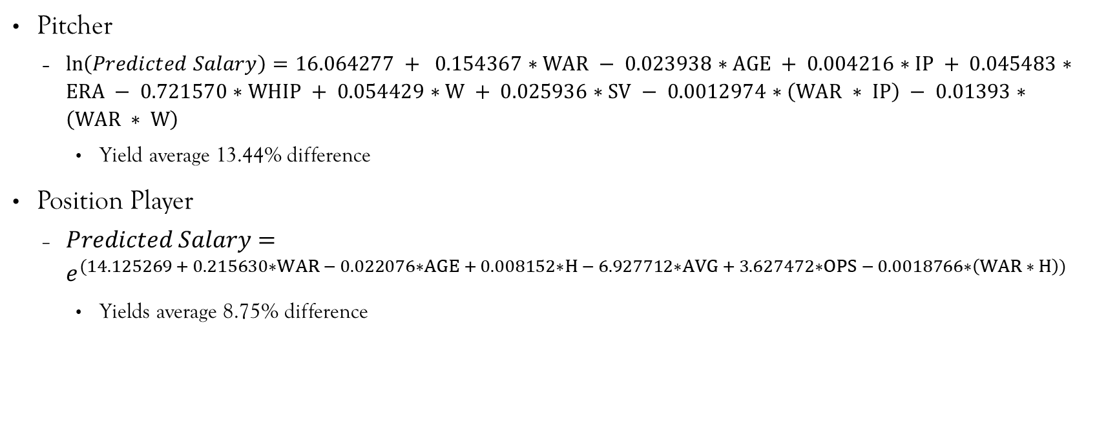
Summary
Pitcher
$\ln\left(Predicted Salary\right)=16.064277 + 0.154367∗WAR − 0.023938∗AGE + 0.004216∗IP + 0.045483∗ERA − 0.721570∗WHIP + 0.054429∗W + 0.025936∗SV − 0.0012974∗\left(WAR ∗ IP\right) − 0.01393∗\left(WAR ∗ W\right)$
Yield average 13.44% difference
Position Player
$Predicted Salary=e^{(14.125269 + 0.215630∗WAR − 0.022076∗AGE + 0.008152∗H − 6.927712∗AVG + 3.627472∗OPS − 0.0018766∗\left(WAR ∗ H\right))}$
Yields average 8.75% difference

Slide 32
Conclusions
Given the Average Percentage Error
Fine tuning is required
Adding other statistic variables
Different regression models
Unknowns that can't be accounted for (Human Error)
Negotiation process
Over valuation
Still great for a front office to use just to get an idea if they are in or out on a player

Slide 33
Questions?

Slide 34
Citations
2024 MLB Free Agents Tracker. (n.d.). Spotrac.com. https://www.spotrac.com/mlb/free-agents/
Standard Stats | Glossary | MLB.com. (n.d.). MLB.com. https://www.mlb.com/glossary/standard-stats
Advanced Stats | Glossary | MLB.com. (n.d.). MLB.com. https://www.mlb.com/glossary/advanced-stats
Zach. (2021, October 4). Exponential regression in R (Step-by-Step). Statology. https://www.statology.org/exponential-regression-in-r/
Ravelo, C. (2022, November 23). Stepwise Regression: What is it and should you use it? Statistics Solutions. https://www.statisticssolutions.com/stepwise-regression-what-is-it-and-should-you-use-it/
Fein, E. C. (2022, June 16). Section 7.3: Moderation Models, Assumptions, Interpretation, and Write up. Pressbooks. https://usq.pressbooks.pub/statisticsforresearchstudents/chapter/moderation-assumptions/

